Slide 1



PRESENTED BY : CS29 GROUP
E
E
Event
Ease
event planning & ticket selling platform

Slide 2

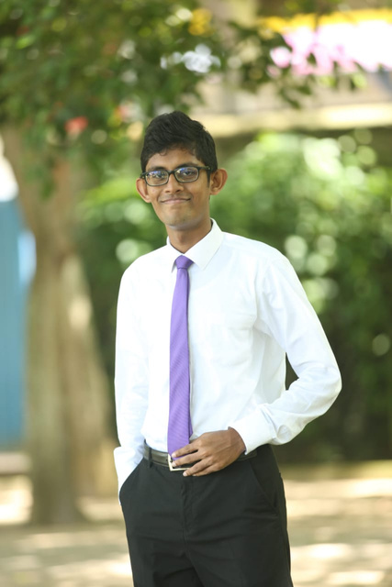
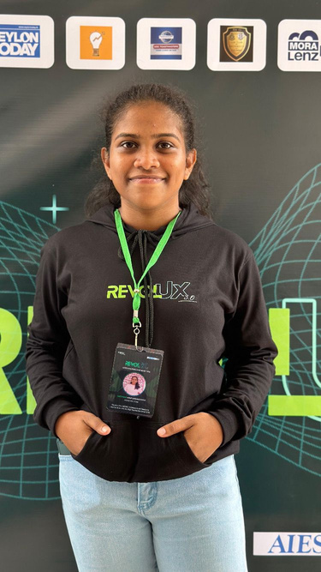

E
E
Event
Ease
THE PROJECT TEAM
Irumi Abeywickrama
Thevindu Fernando
CS 29
Team member
Team member
Supervisor - Mr. T N B Wijethilake
Co - Supervisor -
Nethmi Hapuarachchi
Sachith Abeywardhana
Team member
Team member
event planning & ticket selling system

Slide 3

E
E
Event
Ease
INTRODUCTION
Our integrated event organizing and ticket-selling system centralizes planning, ticket sales, marketing, and attendee management, benefiting event planners, performers, and service providers.
event planning & ticket selling system

Slide 4
E
E
Event
Ease
PROBLEM STATEMENT
Event planners in Sri Lanka face challenges due to fragmented event management processes.
The various activities related organizing an event are done separately on platforms dedicated to each of those activities.
These include critical activities such as finding performers, service providers, marketing, ticket sale and ticket grab.
Music lovers find it challenging to discover recent music events.
Upcoming performances are often difficult to find and access, posing a significant challenge for event discovery.
event planning & ticket selling system

Slide 5
E
E
Event
Ease
SOLUTION
event planning & ticket selling system

Slide 6

E
E
Event
Ease
PROJECT
BOUNDARIES
event planning & ticket selling system

Slide 7
E
E
Event
Ease
Ticket Booking
Scheduling & Organizing Event
Event Browsing
Communicating With Collaborators
Shearing Profiles With Community
User Management
Work Management
Content Management
INSCOPE
event planning & ticket selling system

Slide 8
E
E
Event
Ease
OUTSCOPE
Focuses on event planning and digital ticket sales.
Facilitates coordination with event collaborators, excluding logistics.
Does not handle legal requirements and permits for events.
Offers digital tickets.
Enhances event visibility through listings and promotions, without extensive marketing services.
Marketing event related services.
event planning & ticket selling system

Slide 9


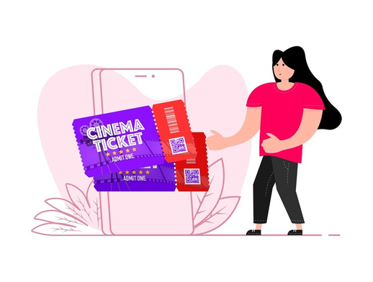


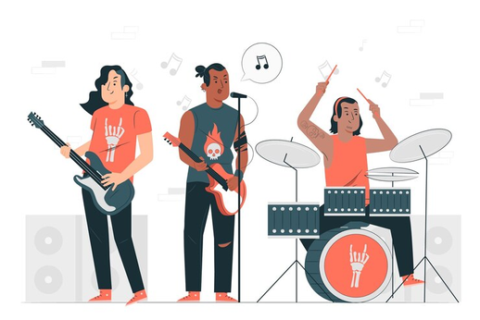




E
E
Event
Ease
USER IDENTIFICATION
admin
guest user
ticket holder
event planner
singer
bands
announcer
DJ & sounds
event decorator
stage supplier

Slide 10

E
E
Event
Ease
FUNCTIONAL REQUIRMENTS
event planning & ticket selling system

Slide 11
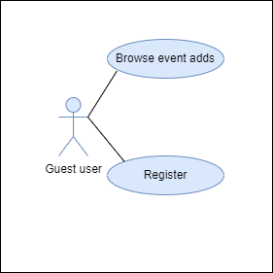
E
E
Event
Ease
GUEST USER
Browse event adds
Register
event planning & ticket selling system

Slide 12
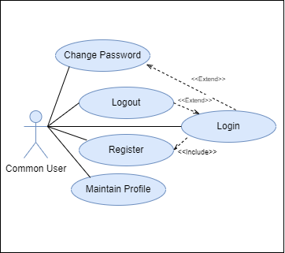
E
E
Event
Ease
COMMON USER
Register
Login
Maintain profile
Change password
Logout
event planning & ticket selling system

Slide 13
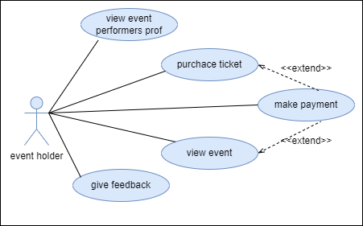
E
E
Event
Ease
TICKET HOLDER
Browse recent events
Purchase tickets
Make payment
View performers’ profiles
Give feedbacks
event planning & ticket selling system

Slide 14
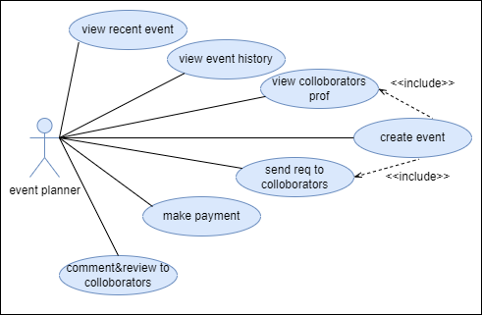
E
E
Event
Ease
EVENT PLANNER
Create event
View collaborators profiles
Send requests
Give feedbacks for event collaborators
View upcoming event status
View event history
Make payment
www.reallygreatsite.com
VWNT

Slide 15

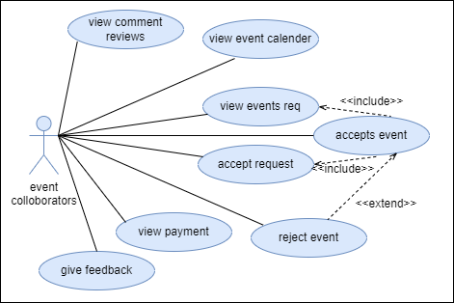
E
E
Event
Ease
EVENT COLLOBORATORS
View event requests
Accept/ reject requests
Accept payments
Give feedback for event
Maintain a calendar
View comments and reviews
View payments
www.reallygreatsite.com
event planning & ticket selling system

Slide 16
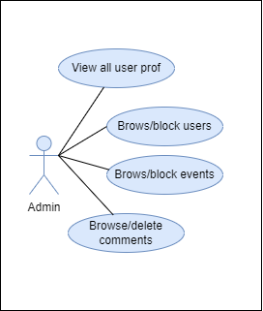
E
E
Event
Ease
Admin
View all user profiles
Browse/Block users
Browse/delete events
View all comments and delete comments
www.reallygreatsite.com
event planning & ticket selling system

Slide 17
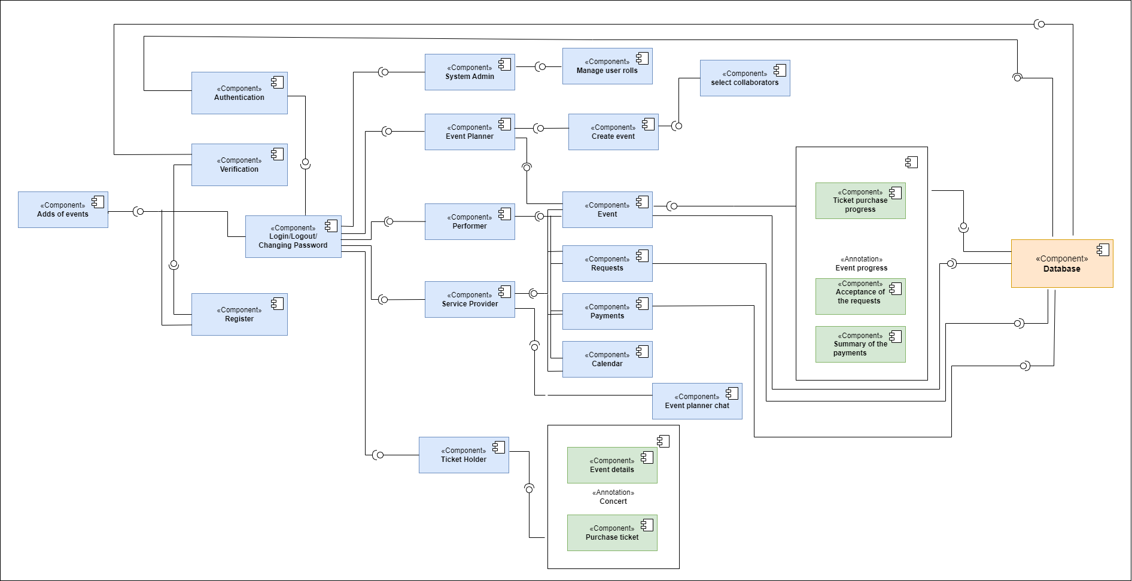
E
E
Event
Ease
COMPONENT DIAGRAM
www.reallygreatsite.com
event planning & ticket selling system

Slide 18

E
E
Event
Ease
QUALITY
ATTRIBUTES
event planning & ticket selling system

Slide 19




E
E
Event
Ease
Usability
Simple unclustered user interface
Clear navigation,intuitive design,accesible features
Availability
System needs to be working 24/7
Registered user should be able to pay fine
anytime of the day
Security
Users will be authenticated at login
Having a password security policy
Login credentials will be encrypted with MD5
For online payments secure methods will be
used
Performance
Browser and server cache will be enabled
within the system
Using compressed images to reduce
load time
Third party frameworks are not used
event planning & ticket selling system

Slide 20

E
E
Event
Ease
FEASIBILITY
STUDY
event planning & ticket selling system

Slide 21



E
E
Event
Ease
TECHNICAL FEASIBILITY
Suitable technologies with community support.
Development team is familiar with the chosen technologies.
mvc architecture is used.
event planning & ticket selling system

Slide 22










E
E
Event
Ease
TECNOLOGIES TO BE USED
Frontend Development
Backend Development
Diagrams & Modelings
HTML
CSS
JS
UI/UX and Prototyping
Version Control
Documentation
Text Editors
Collaboration
event planning & ticket selling system

Slide 23



E
E
Event
Ease
ECONOMIC FEASIBILITY
The free tier capacity offered by a suitable cloud provider is sufficient
for handling a moderate level of traffic to the site.
Emails notification panel will keep users updated at no cost
All software applications and tools are free and open-source, no hardware cost
event planning & ticket selling system

Slide 24



E
E
Event
Ease
LEGAL & ETHICAL FEASIBILITY
User identities are verified via email addresses.
Platform built in compliance with licenses of open-source software used.
No one access the users details
event planning & ticket selling system

Slide 25
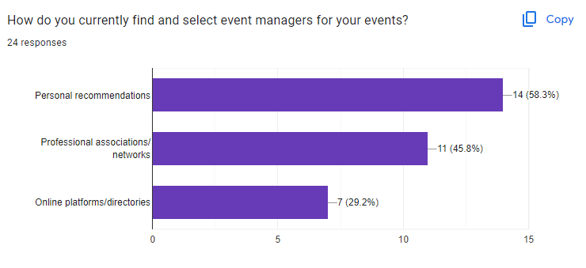
E
E
Event
Ease
SOCIAL FEASIBILITY
The following survey results show that the majority of the target community has a positive opinion about the functionalities of the project.
event planning & ticket selling system

Slide 26
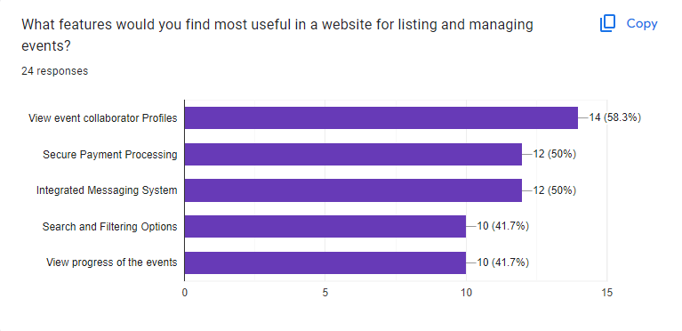
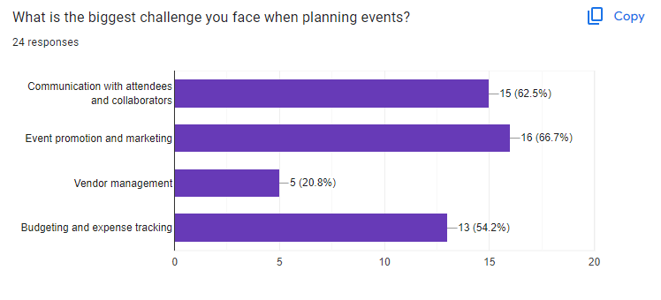
E
E
Event
Ease
event planning & ticket selling system

Slide 27
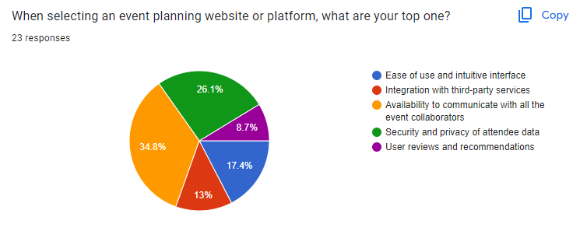
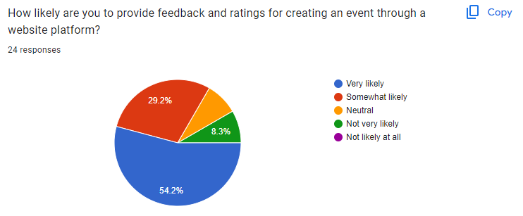
E
E
Event
Ease
event planning & ticket selling system

Slide 28
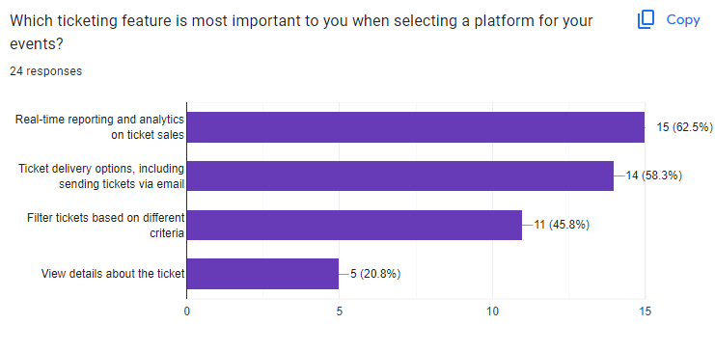
E
E
Event
Ease
event planning & ticket selling system

Slide 29

E
E
Event
Ease
SCHEDULE FEASIBILITY
Estimated man-hours for the project completion
Weekdays working hours = 5 hours
Weekend working hours = 5 hours
Number of group members = 4
Number of weeks = 36
Total man hours = (5 + 5) * 4 * 36 hours = 1440 hours
Software Development Methodology - Iterative Waterfall method
event planning & ticket selling system
event planning & ticket selling system

Slide 30
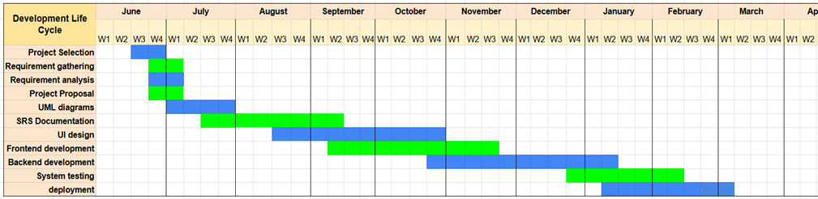
E
E
Event
Ease
GANNT CHART
www.reallygreatsite.com
event planning & ticket selling system

Slide 31

E
E
Event
Ease
WORKLOAD DISTRIBUTION
event planning & ticket selling system

Slide 32
E
E
Event
Ease
Thevindu Dilmith
Sachith Avintha
Admin
Guest User
Event performers
Service Providers
Irumi Theekshana
Nethmi Hapuarachchi
Event Planner
Event Performers
Ticket holder
Service Providers
www.reallygreatsite.com
event planning & ticket selling system

Slide 33

E
E
Event
Ease
THANK YOU...
event planning & ticket selling system

Slide 34

E
E
Event
Ease
Q&A
event planning & ticket selling system

